Slide 1


SMART HOME WITH SMART SECURITY
Zeroth review
Department of Electronics Engineering,
MIT Campus, Anna University
Project Guide:
Dr.A.VIJI
TEACHING FELLOW
DEPARTMENT OF ELECTRONICS ENGINEERING
MIT CAMPUS
Batch Members:
PRAKASH J - 2018504042
BARANIDHARAN S - 2018504517
ROHITH VARON SS - 2018504590
VELMURUGAN M - 2018504626

Slide 2
OUTLINE
Introduction
Objective
Drawback of Existing system
Literature survey
Block diagram
Workflow
Requirements
References

Slide 3
INRODUCTION
Today, There is an increasing demand of automated Systems . This project focuses on a system that provides features of home Automation relying on internet of things to operate easily .
The major concerns in the IOT network are the security and privacy. The security and privacy is required in the network because there could be a chance of the misconfiguration of the users.
There are eaves dropping attacks which capture few types of information like brute force attack.
The project mainly aims to overcome the shortcomings of home security systems by providing a new Security algorithm for smart homes so that secured communication has been developed .

Slide 4
OBJECTIVE
To build up a home automation system utilizing Raspberry pi Model and node MCU.
To create an interface for user using frontend tool.
To implement intruder detection using motion detection.
To protect the home automation system from hackers by AES algorithm.

Slide 5
DRAWBACKS OF EXISTING SYSTEM
Bluetooth based home automation system.
Bluetooth network has limited range of 10 meters if the smartphone is out of range, then it will not be able to control the home appliances.
Voice recognized based home automation system.
The communication between user and voice recognition tool depends on signal to noise ratio (SNR), if voice signal is noisy then communication can highly effect and the system will fail to show accuracy.

Slide 6
DRAWBACKS OF EXISTING SYSTEM
ZigBee based wireless Home automation system.
It has physical range is between 10 to 20 meters, which can increase up to 150 meters by using direct sequence spread spectrum (DSSS).
GSM based Home automation system.
There is no guarantee text message deliver to the system every time so it is not a reliable system.
Smart security using DES algorithm.
DES has a 56-bit key which raises the possibility of 2⁵⁶ possible keys which make brute force possible.

Slide 7
LITERATURE SURVEY
TITLE | YEAR | AUTHOR | INFERENCE
Home Automation using Internet of Things | 2015 | Vinay sagar K,usuma S M | This paper present a Home Automation system(HAS) using Intel Galileo that employs the integration of cloud networking, wireless communication, to provide the user with remote control of various lights, fans, and appliances within their home and storing the data in the cloud.
Smart Security and Smart Home Automation | 2018 | Sudha Kousalya , G. Reddi Priya, R. Vasanthi, B Venkatesh | The project focuses on controlling lights and fans referred as Home Automation and providing Smart security by sending an captured image through an E-mail to the owner using internet when an object is detected. By using “Node MCU” Module we are going to implement this project. This will be more helpful for Handicapped and aged people.

Slide 8
LITERATURE SURVEY
TITLE | YEAR | AUTHOR | INFERENCE
Smart Home Automation Using Machine Learning Algorithms . | 2020 | John Jaihar, Neehal Lingayat, Patel Sapan Vijaybhai, | These systems need to carefully analyze the user needs and the conditions of the surroundings in order to predict future actions and also minimizes user interaction. Traditional home automation system that provides only remote access and control are not that effective in terms of being ‘smart’,
The Search and Improvement of DES Algorithm for Data Transmission Security in SCADA. | 2019 | Xu Xudong, Tian Na. | The wide application of DES has a short key in the world , which cannot meet the demand of the current network security . The DES algorithm is proposed and implemented in the C++ language ,which is based on the deep research of data encryption methods and DES algorithm particularly.

Slide 9
BLOCK DIAGRAM
ANDROID APP or WEB
(CLIENT SOCKET)
ENCRYPTION USING AES ALGORITHM
RASPBERRY PI
CAMERA MODULE
SERVER INTERFACE
USER INTERFACE
RELAY BOARD
SECURITY SYSTEM
MOTION SENSOR
TEMPERATURE SENSOR
AUTOMATION SYSTEM
FAN
LIGHT
DOOR CONTROL

Slide 10
WORK PLAN
FIRST REVIEW
Studying the working principle and developing the code
SECOND REVIEW
Connecting a user interface with the raspberry pi, Developing a code and interface with raspberry pi
THIRD REVIEW
Hardware implementation and analyzing the output

Slide 11
REQUIREMENTS
HARDWARE | SOFTWARE
RASPBERRY PI MODEL 3B+ NODE MCU RELAY MOTION SENSOR CAMERA MODULE SMOKE SENSOR DOOR LOCK DC MOTOR LIGHTS | JAVA SCRIPT PYTHON PUTTY VNC VIEWER

Slide 12
REFERENCES
Antonakakis, Manos, et al. "Understanding the mirai botnet." 26th {USENIX} security symposium ({USENIX} Security 17). 2017.
Subramanyan, Pramod, et al. "Verifying information flow properties of firmware using symbolic execution." 2016 Design, Automation & Test in Europe Conference & Exhibition (DATE). IEEE, 2016.
DeMarinis, Nicholas, and Rodrigo Fonseca. "Toward usable network traffic policies for IoT devices in consumer networks." Proceedings of the 2017 Workshop on Internet of Things Security and Privacy. 2017.
Lau, Josephine, Benjamin Zimmerman, and Florian Schaub. "Alexa, are you listening? privacy perceptions, concerns and privacy-seeking behaviors with smart speakers." Proceedings of the ACM on HumanComputer Interaction 2.CSCW (2018): 1-31.
Hang, Guoming, et al. "Dolphinattack: Inaudible voice commands."Proceedings of the 2017 ACM SIGSAC Conference on Computer and Communications Security. 2017.

Slide 13
THANK YOU

Slide 14
SMART HOME WITH SMART SECURITY
First review
Department of Electronics Engineering,
MIT Campus, Anna University
Project Guide:
Dr.A.VIJI
TEACHING FELLOW
DEPARTMENT OF ELECTRONICS ENGINEERING
MIT CAMPUS
Batch Members:
PRAKASH J - 2018504042
BARANIDHARAN S - 2018504517
ROHITH VARON SS - 2018504590
VELMURUGAN M - 2018504626

Slide 15
OBJECTIVE
* TO BUILD UP A HOME AUTOMATION SYSTEM UTILIZING RASPBERRY PI MODEL AND NODE MCU.
*THEN WE HAVE CREATED A USER FRIENDLY INTERFACE (WITH SECURED LOGIN CREDENTIALS) SO THAT THE USER IS ABLE TO BEND THE RULES .
* WE HAVE DEVELOPED PROGRAMS FOR EACH DEVICES TO INTERACT EFFECTIVELY
* THEN WE HAVE BEEN WORKING ON ADDING ADDITIONAL SECURITY FEATURES TO PREVENT UNAUTHORIZED ENTRY OR ACCESS.

Slide 16
BLOCK DIAGRAM
ANDROID APP or WEB
(CLIENT SOCKET)
ENCRYPTION USING AES ALGORITHM
RASPBERRY PI
CAMERA MODULE
SERVER INTERFACE
USER INTERFACE
RELAY BOARD
SECURITY SYSTEM
MOTION SENSOR
TEMPERATURE SENSOR
AUTOMATION SYSTEM
FAN
LIGHT
DOOR CONTROL

Slide 17
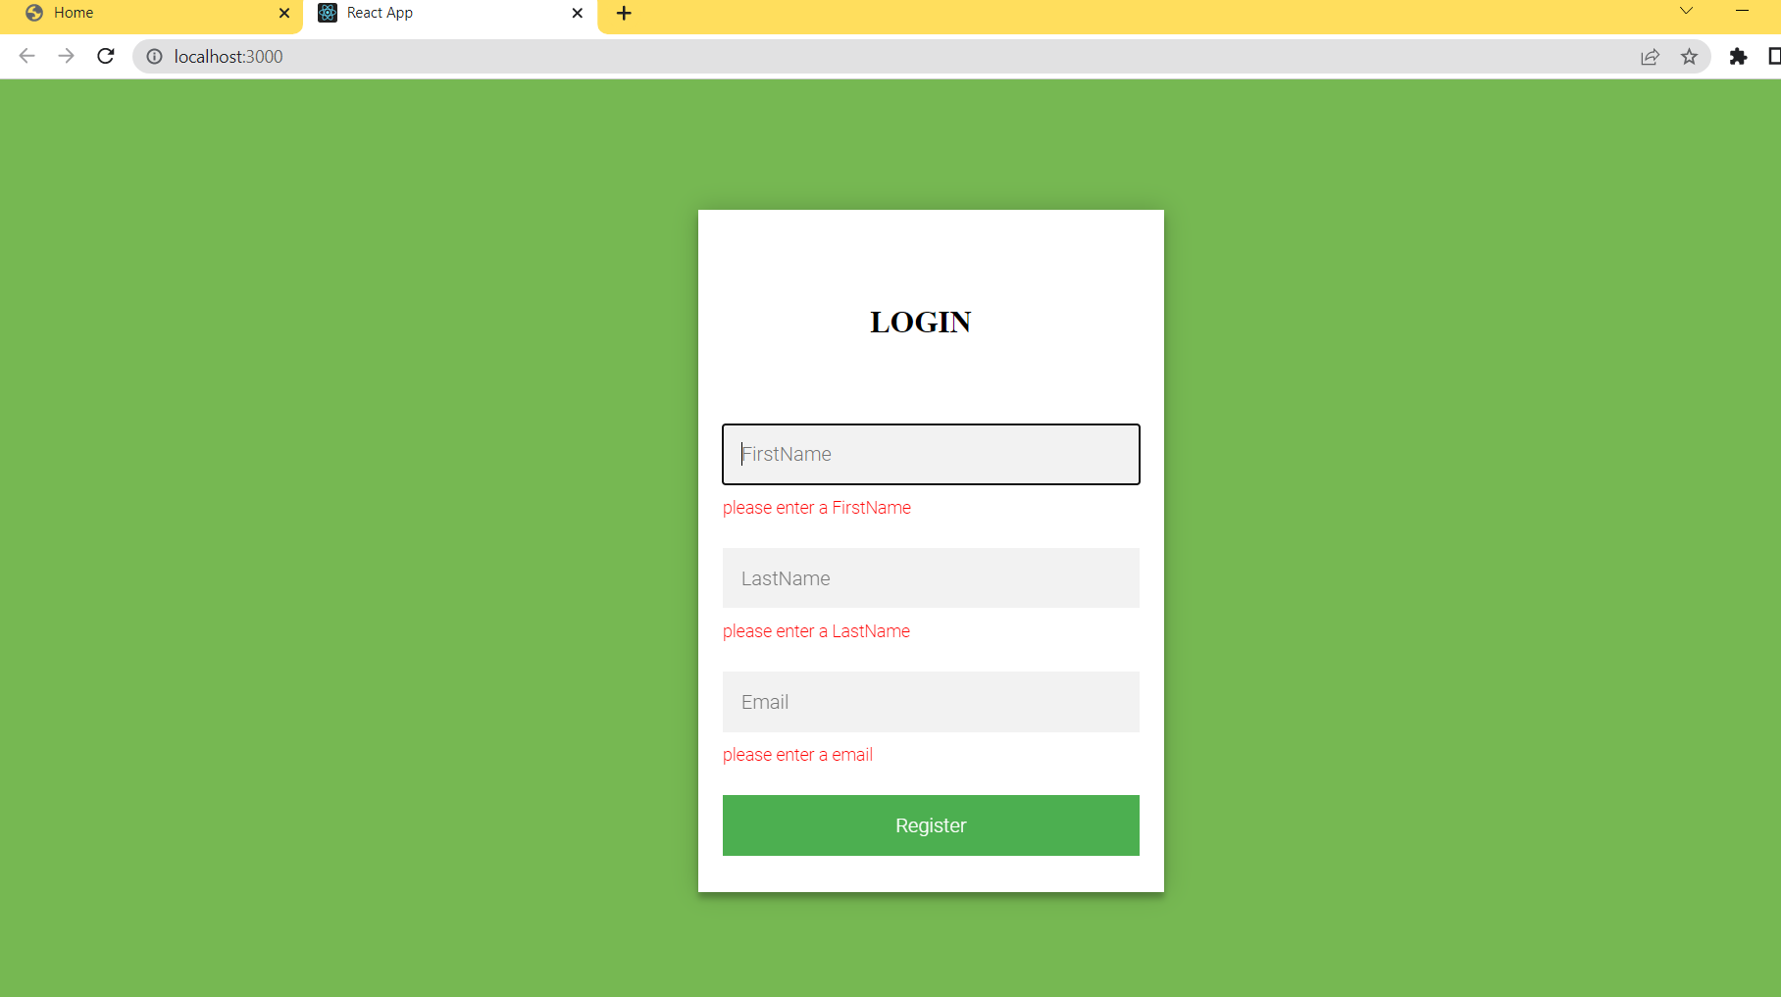
USER INTERFACE LOGIN CREDENTIALS

Slide 18
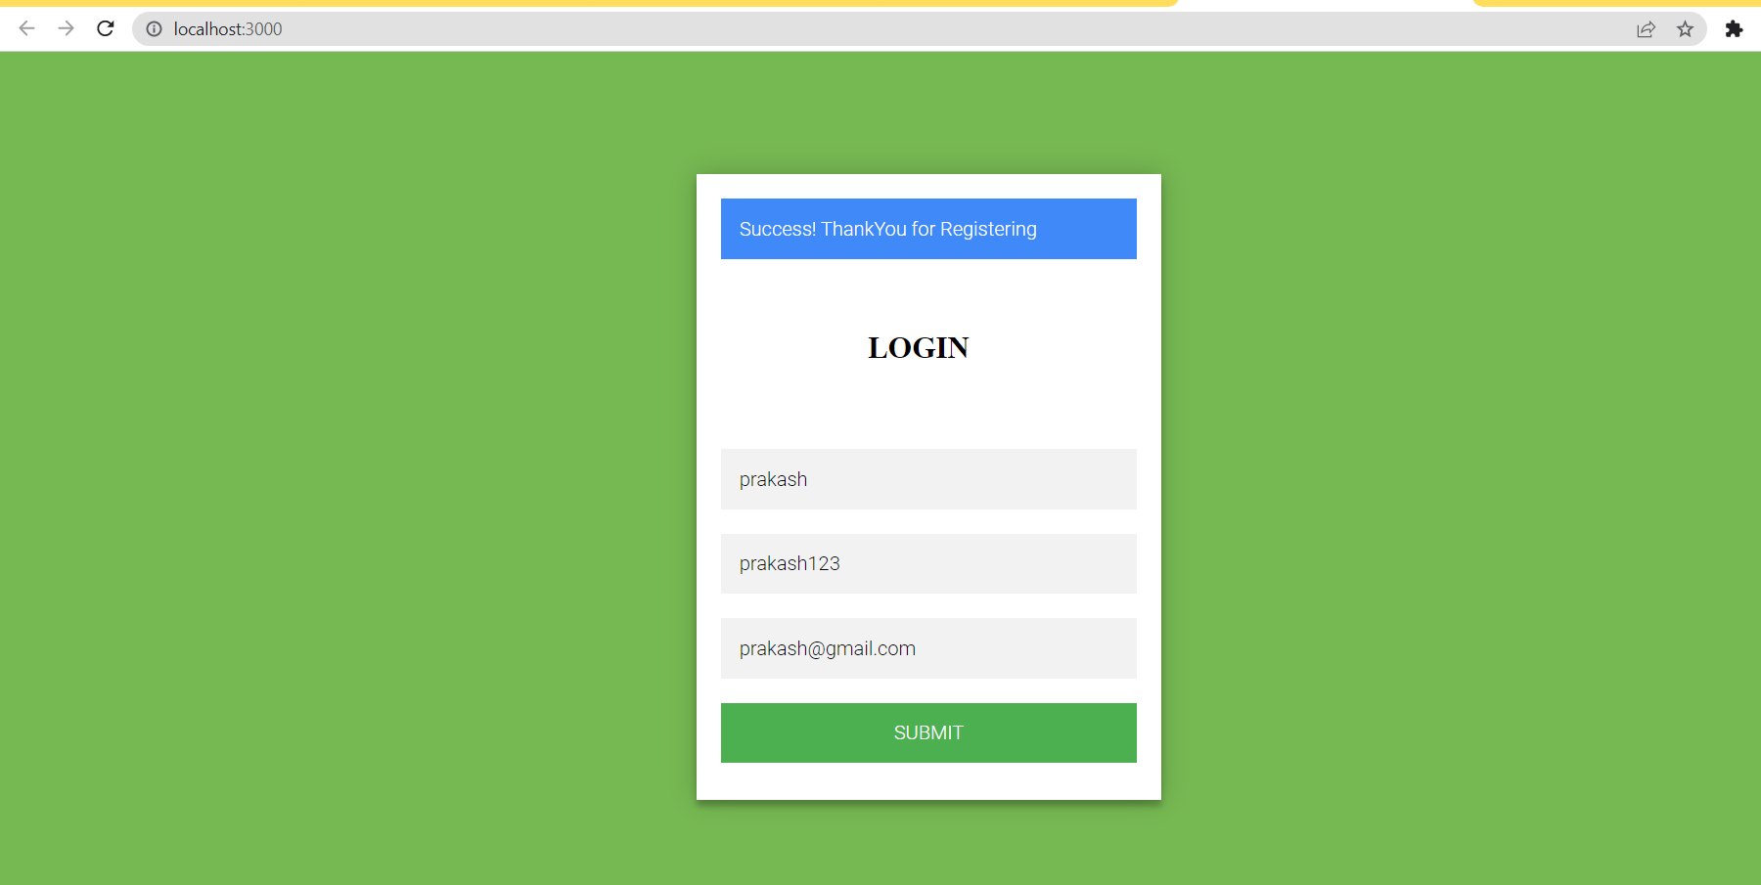
USER INTERFACE LOGIN CREDENTIALS

Slide 19
USER INTERFACE-ANDROID WEBSITE
TO MAKE A RESIDENTIAL CONTROL SYSTEM MORE UNDERSTANDABLE AND CONVENIENT, NEW TECHNOLOGIES HAVE LEAD TO THE INVENTION OF “SMART” PRODUCTS THAT CAN BE CONTROLLED REMOTELY. FOR EXAMPLE, PRODUCTS FOR HEATING, TELEVISION, DOOR, AND LIGHT CAN NOW BE CONTROLLED THROUGH WIFI OR BLUETOOTH. THESE PRODUCTS TOGETHER CREATE THE NEED FOR A “HOME AUTOMATION APP”THAT CONTROLS ALL SMART ACCESSORIES OF A HOUSE THROUGH ONE CHANNEL

Slide 20

USER INTERFACE-ANDROID WEBSITE
HTML-STRUCTURE
CSS-PRESENTATION/APPEARANCE
JAVASCRIPT-DYNAMISM/ACTION

Slide 21
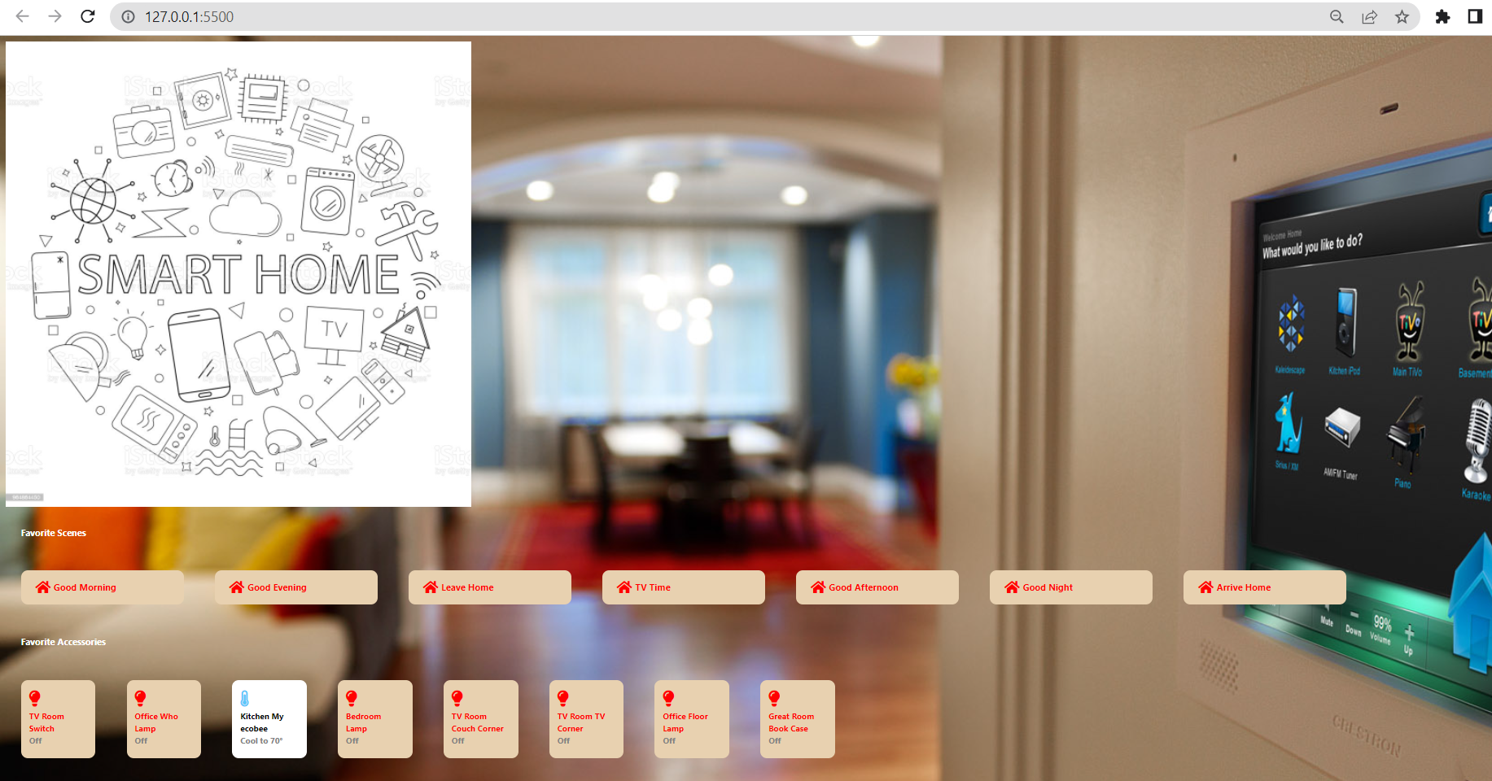

Slide 22
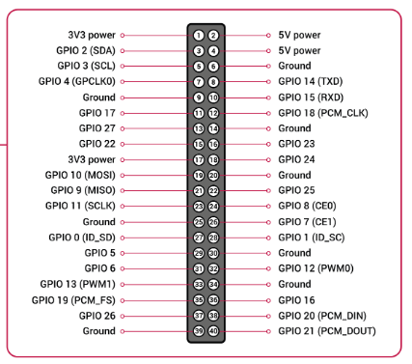
Raspberry pi pin configuration
Vin pins
Ground pins
GPIO pins
PWM pins
SPI BUS
I2C Pins
TX and RX

Slide 23
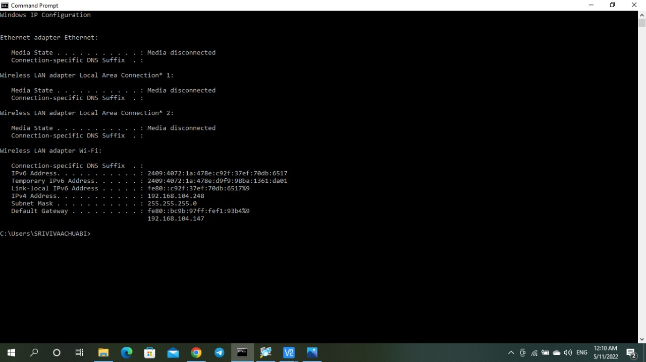
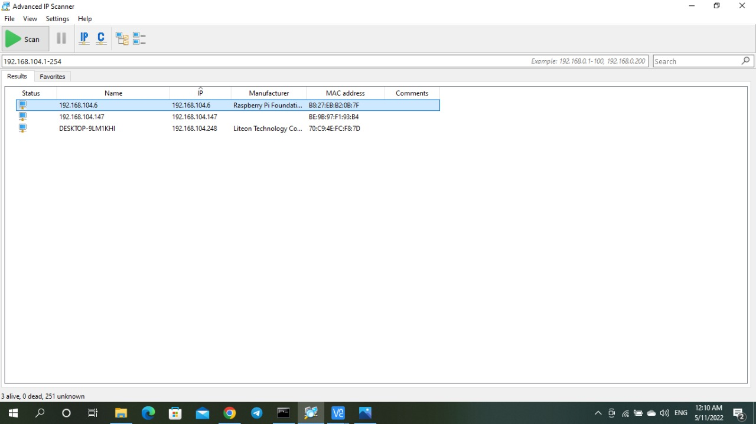
To Find a IP address which is assigned to Raspberry pi, laptop and mobile

Slide 24

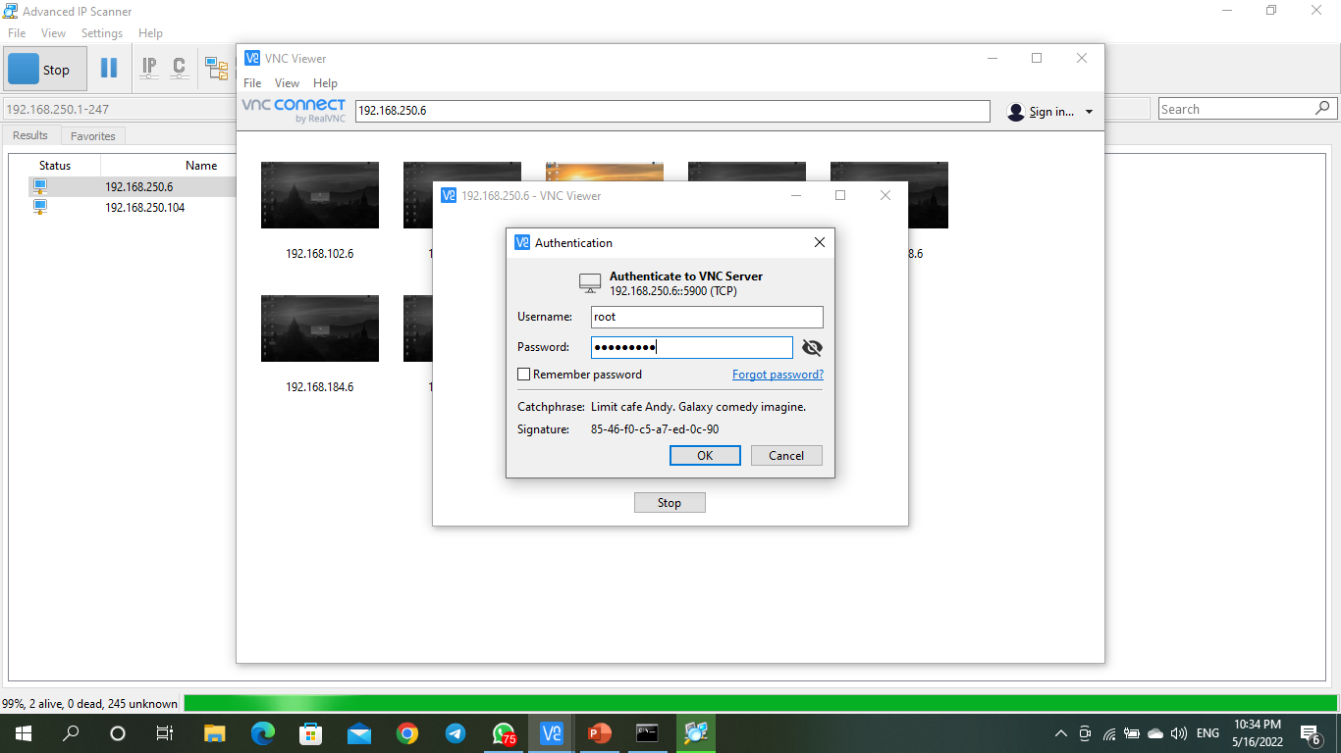
Raspberry pi connection with login credentials

Slide 25
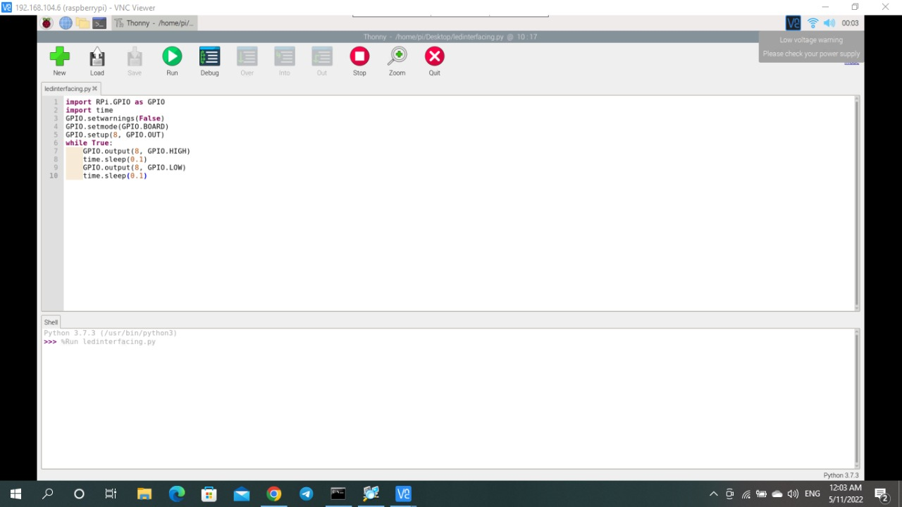
Led interfacing with Raspberry pi
import RPi.GPIO as GPIO
import time
GPIO.setwarnings(False)
GPIO.setmode(GPIO.BOARD)
GPIO.setup(8, GPIO.OUT)
while True:
GPIO.output(8, GPIO.HIGH)
time.sleep(2)
GPIO.output(8, GPIO.LOW)
time.sleep(2)

Slide 26
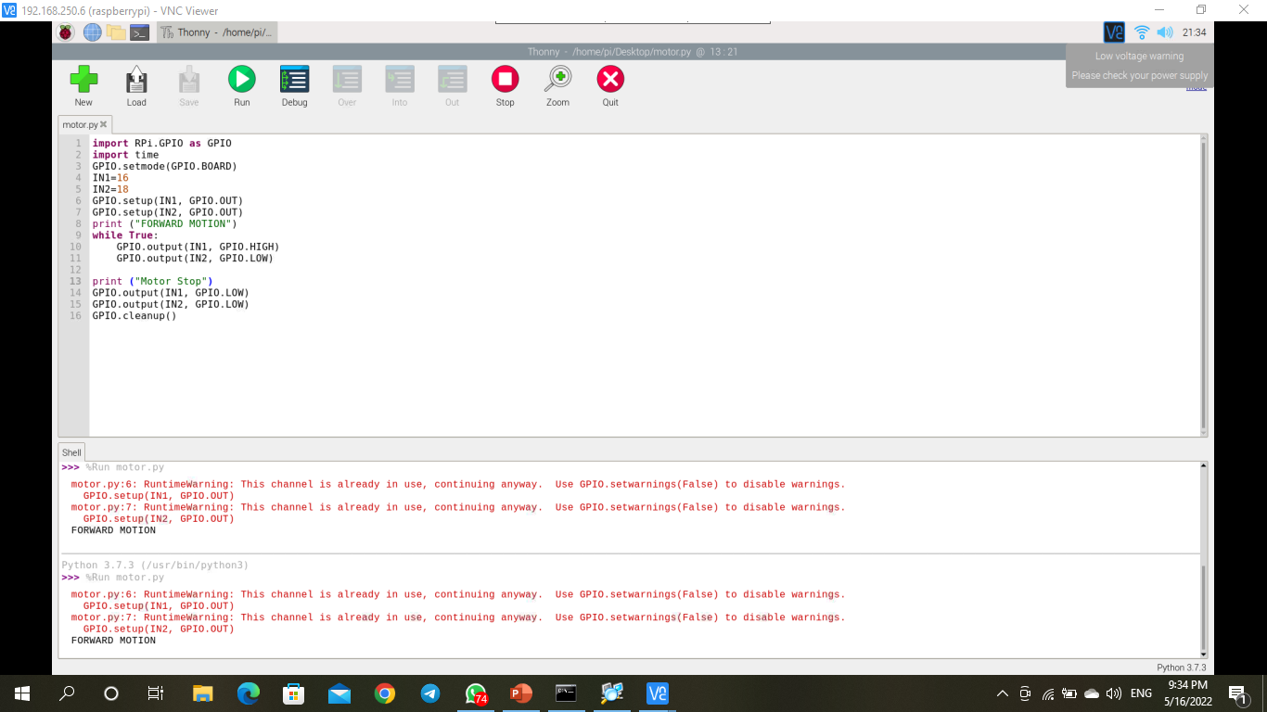
Motor interfacing with Raspberry pi
import RPi.GPIO as GPIO
import time
GPIO.setmode(GPIO.BOARD)
IN1=16
IN2=18
GPIO.setup(IN1, GPIO.OUT)
GPIO.setup(IN2, GPIO.OUT)
print ("FORWARD MOTION")
while True:
GPIO.output(IN1, GPIO.HIGH)
GPIO.output(IN2, GPIO.LOW)
print ("Motor Stop")
GPIO.output(IN1, GPIO.LOW)
GPIO.output(IN2, GPIO.LOW)
GPIO.cleanup()

Slide 27
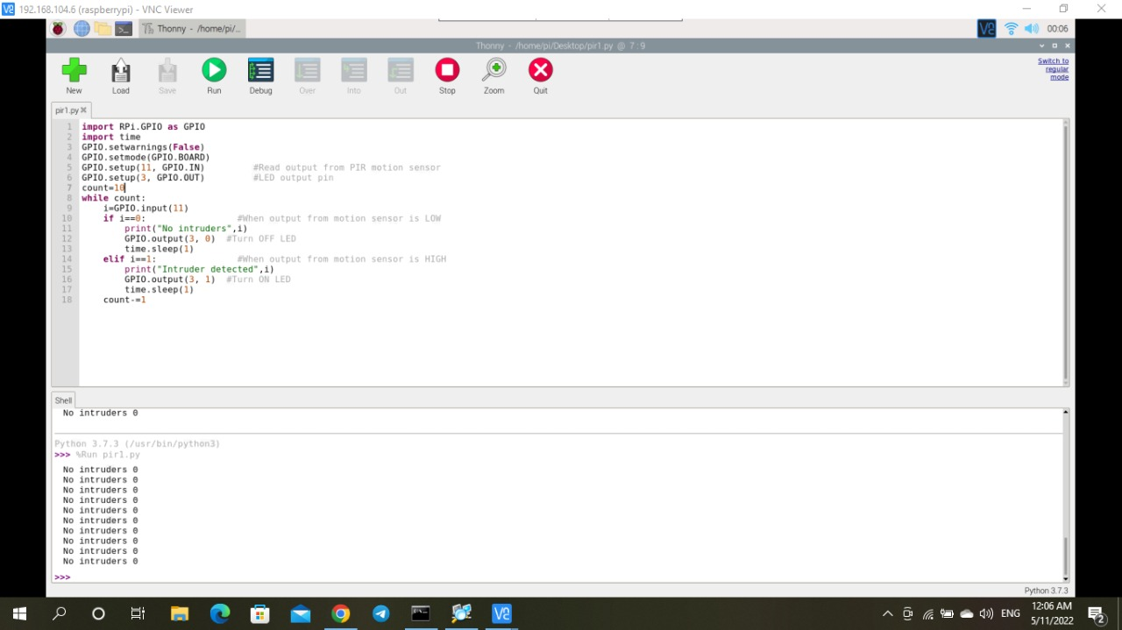
PIR sensor interfacing with Raspberry pi
import RPi.GPIO as GPIO
import time
GPIO.setwarnings(False)
GPIO.setmode(GPIO.BOARD)
GPIO.setup(11, GPIO.IN) #Read output from PIR motion sensor
GPIO.setup(3, GPIO.OUT) #LED output pin
count=10
while count:
i=GPIO.input(11)
if i==0: #When output from motion sensor is LOW
print("No intruders",i)
GPIO.output(3, 0) #Turn OFF LED
time.sleep(1)
elif i==1: #When output from motion sensor is HIGH
print("Intruder detected",i)
GPIO.output(3, 1) #Turn ON LED
time.sleep(1)
count-=1

Slide 28
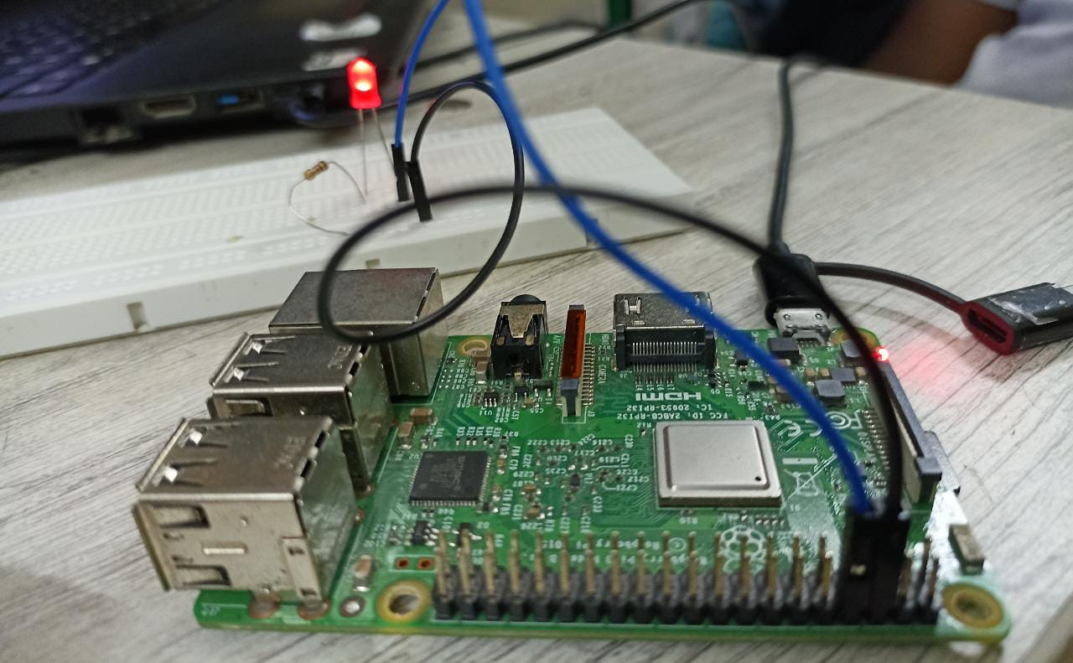
Output for led interfacing with Raspberry pi

Slide 29
WORK PLAN
SECOND REVIEW
Connecting a user interface with the raspberry pi, Developing a code and interface with raspberry pi
THIRD REVIEW
Hardware implementation and analyzing the output

Slide 30
REFERENCES
Antonakakis, Manos, et al. "Understanding the mirai botnet." 26th {USENIX} security symposium ({USENIX} Security 17). 2017.
Subramanyan, Pramod, et al. "Verifying information flow properties of firmware using symbolic execution." 2016 Design, Automation & Test in Europe Conference & Exhibition (DATE). IEEE, 2016.
DeMarinis, Nicholas, and Rodrigo Fonseca. "Toward usable network traffic policies for IoT devices in consumer networks." Proceedings of the 2017 Workshop on Internet of Things Security and Privacy. 2017.
Lau, Josephine, Benjamin Zimmerman, and Florian Schaub. "Alexa, are you listening? privacy perceptions, concerns and privacy-seeking behaviors with smart speakers." Proceedings of the ACM on HumanComputer Interaction 2.CSCW (2018): 1-31.
Hang, Guoming, et al. "Dolphinattack: Inaudible voice commands."Proceedings of the 2017 ACM SIGSAC Conference on Computer and Communications Security. 2017.

Slide 31
THANK YOU

Slide 32
SMART HOME WITH SMART SECURITY
Second Review
Department of Electronics Engineering,
MIT Campus, Anna University
Project Guide:
Dr.A.VIJI
TEACHING FELLOW
DEPARTMENT OF ELECTRONICS ENGINEERING
MIT CAMPUS
Batch Members:
PRAKASH J - 2018504042
BARANIDHARAN S - 2018504517
ROHITH VARON SS - 2018504590
VELMURUGAN M - 2018504626

Slide 33
OBJECTIVE
To build up a home automation system utilizing Raspberry pi Model.
To create an interface for user using frontend tool.
To create a connection between the user frontend and Raspberry pi.
To implement intruder detection using motion detection.
To monitor the room temperature using the temperature sensor.

Slide 34
BLOCK DIAGRAM
ANDROID APP or WEB
(CLIENT SOCKET)
ENCRYPTION USING AES ALGORITHM
RASPBERRY PI
CAMERA MODULE
SERVER INTERFACE
USER INTERFACE
RELAY BOARD
SECURITY SYSTEM
MOTION SENSOR
TEMPERATURE SENSOR
AUTOMATION SYSTEM
FAN
LIGHT
DOOR CONTROL

Slide 35

PREVIOUS PROGRESS RECAP
Developed a website for monitoring and controlling the home automation system.
Debugged the code to remove errors.
Interfaced the LED with Raspberry pi

Slide 36
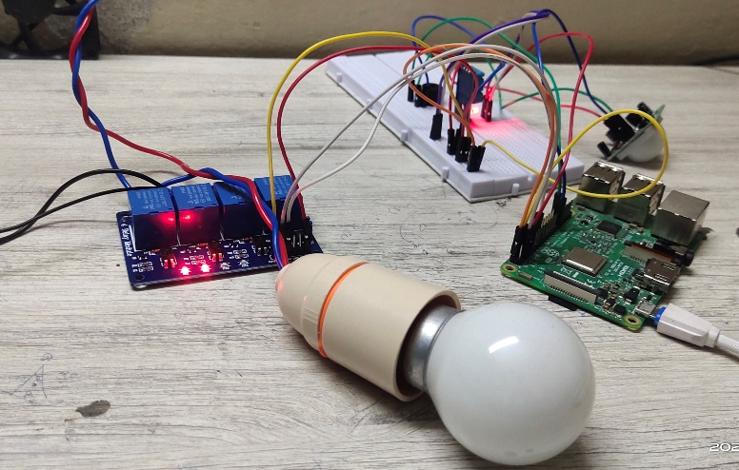
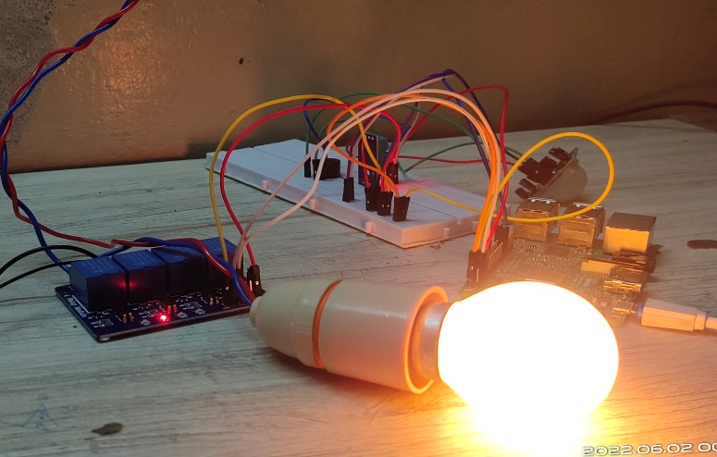
CURRENT PROGRESS
The bulb is connected to a 220v power supply and the relay act as a key to transmit a high and low signal from the raspberry.
The light is connected and work according to raspberry pi command.
The command is generated from the created website.
When we turn on the light switch from the website the light will be turn on otherwise it is in off stage.

Slide 37
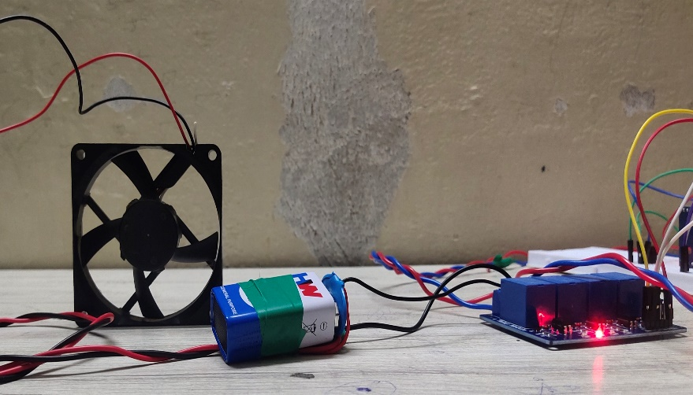
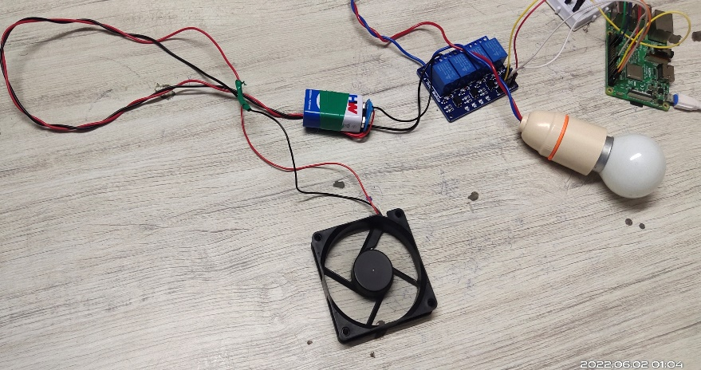
CURRENT PROGRESS
The Fan is connected to a 9v power supply and the relay act as a key to transmit a high and low signal from the raspberry.
The Fan is connected and work according to raspberry pi command.
The command is generated from the created website.
When we turn on the fan switch from the website the light will be turn on otherwise it is in off stage.

Slide 38
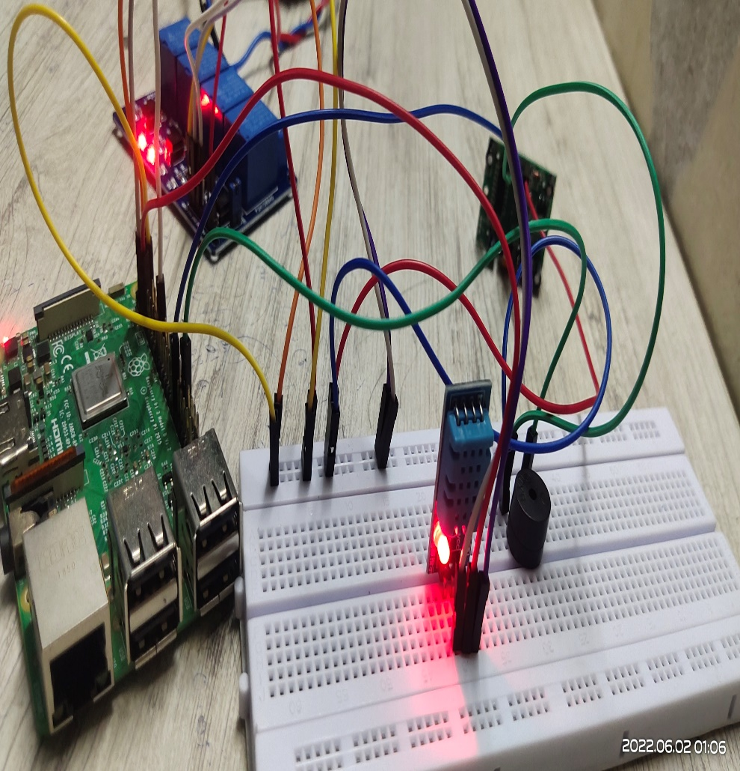
CURRENT PROGRESS
The temperature sensor senses the current temperature and humidity of the room.
The DHT11 has three pins positive and ground pin are connected to the raspberry 5v pin and ground pin respectively.
The data pin is connected to the 7th pin of the raspberry.
The sensor collects the data and transmit to raspberry.
From raspberry the website collects the data and give an alert if the room temperature is high.

Slide 39
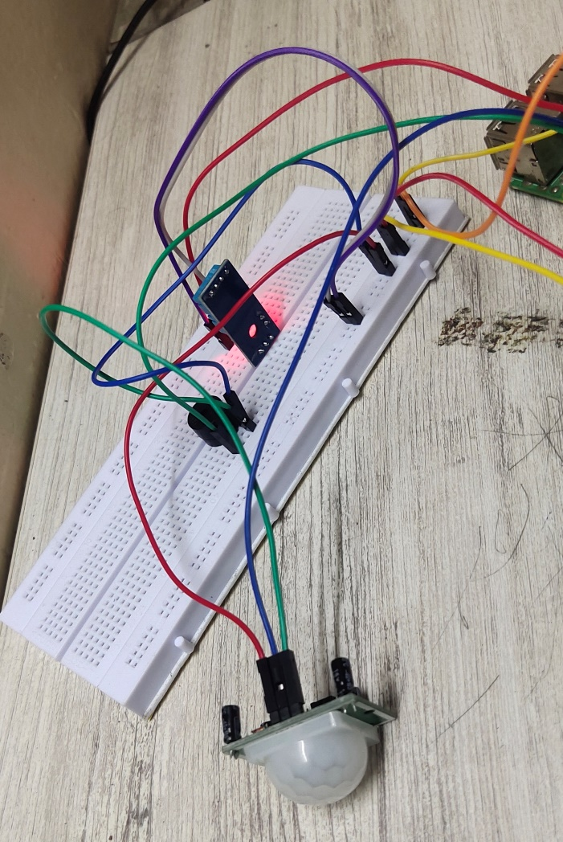
CURRENT PROGRESS
The PIR sensor senses the motion of the intruder who enters the house.
It senses only upto 1m distance.
The sensor transmit the information to raspberry and the buzzer will be turn on if the intruder detects otherwise the buzzer is in off stage.
It senses by the temperature that comes from human body.

Slide 40
FACE RECOGNITION
DATA GATHERING
TRAINING
RECONGNITION
CAPTURE THE FACE AND SAVE IT IN A FOLDER
IF RASPBERRY PI RECONGNIZES THE FACE
NO
YES
DOOR UNLOCKS
YES
DOOR UNLOCKS
FIRST REVIEW
13/9/2021
8

Slide 41
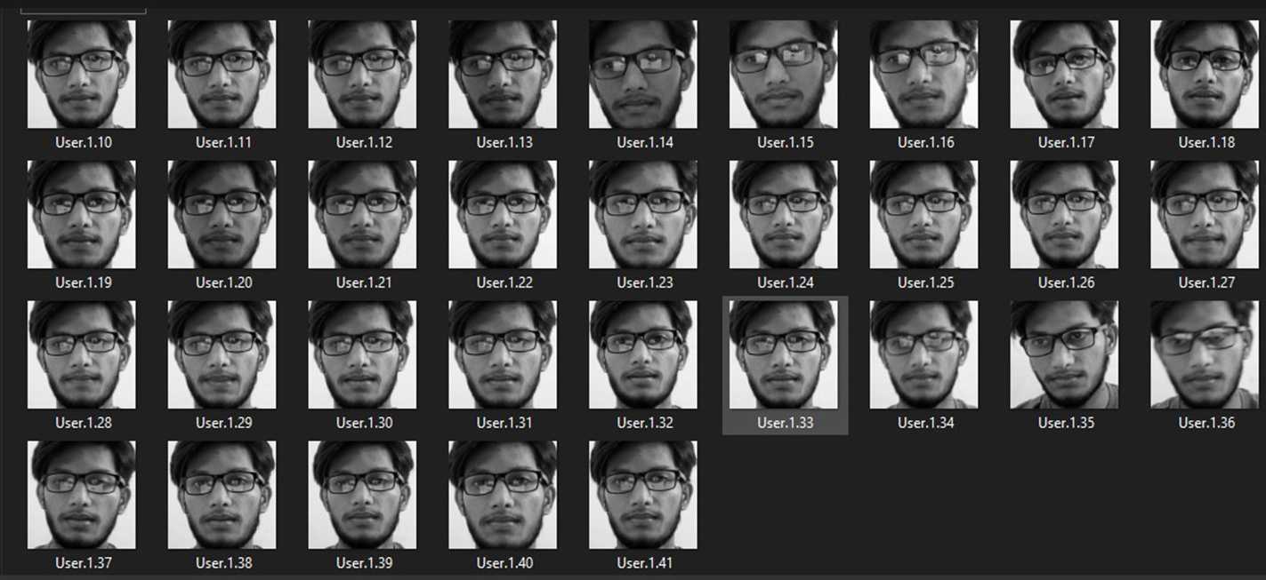
DATA GATHERING
Capture the image
Convert the image into grey scale
Then detect the face from the image using face detector
Create a folder to store the data.

Slide 42
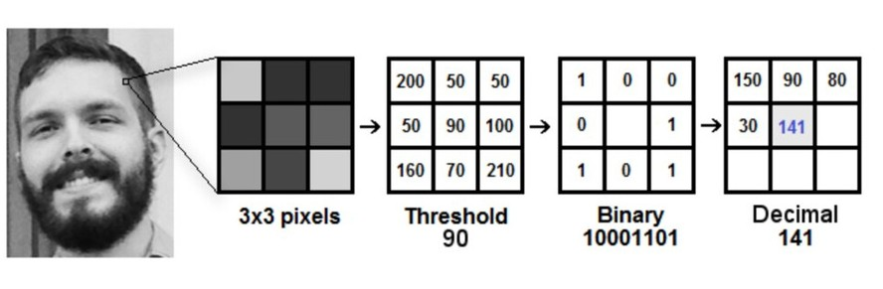
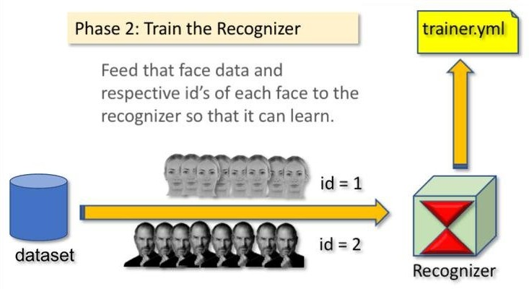
TRAINING THE RECOGNIZER
After gathering the face samples train the recognizer for these samples so that it can predict the faces accurately
Create LBPH [LOCAL BINARY PATTERN HISTOGRAM] face recognizer
Convert PIIL image into a numpy image

Slide 43
FACE RECOGNITION
Recognize face from the live video.
Once the raspberry pi recognizes any saved face , it will make the relay module high to open the solenoid lock
if the sample doesn't match it will capture the image and save it to a folder.

Slide 44
PROBLEMS FACED
To connect an user interface website with the Raspberry pi ,we faced some errors .
PIR Sensor didn’t find the intruder perfectly ,we solved this problem by adjusting the sensitivity and modifying the codes.
For showing the alert system in the website we faced some errors because raspberry and website interface doesn’t support this alert system in website.
While interfacing the raspberry does not accept the local host so we install a new update and then make raspberry pi to accept the website which we created.

Slide 45
TO BE DONE IN REVIEW 3
Integrating all the components and working model of the prototype

Slide 46
REFERENCES
Antonakakis, Manos, et al. "Understanding the mirai botnet." 26th {USENIX} security symposium ({USENIX} Security 17). 2017.
Subramanyan, Pramod, et al. "Verifying information flow properties of firmware using symbolic execution." 2016 Design, Automation & Test in Europe Conference & Exhibition (DATE). IEEE, 2016.
DeMarinis, Nicholas, and Rodrigo Fonseca. "Toward usable network traffic policies for IoT devices in consumer networks." Proceedings of the 2017 Workshop on Internet of Things Security and Privacy. 2017.
Lau, Josephine, Benjamin Zimmerman, and Florian Schaub. "Alexa, are you listening? privacy perceptions, concerns and privacy-seeking behaviors with smart speakers." Proceedings of the ACM on HumanComputer Interaction 2.CSCW (2018): 1-31.
Hang, Guoming, et al. "Dolphinattack: Inaudible voice commands."Proceedings of the 2017 ACM SIGSAC Conference on Computer and Communications Security. 2017.

Slide 47
THANK YOU

Slide 48
SMART HOME WITH SMART SECURITY
Third Review
Department of Electronics Engineering,
MIT Campus, Anna University
Project Guide:
Dr.A.VIJI
TEACHING FELLOW
DEPARTMENT OF ELECTRONICS ENGINEERING
MIT CAMPUS
Batch Members:
PRAKASH J - 2018504042
BARANIDHARAN S - 2018504517
ROHITH VARON SS - 2018504590
VELMURUGAN M - 2018504626

Slide 49
OUTLINE
Objective
Block Diagram
Previous progress Recap
Current progress
Problems Faced
Work plan
References

Slide 50
OBJECTIVE
To build up a home automation system utilizing Raspberry pi Model.
To create an interface for user using frontend tool.
To create a connection between the user frontend and Raspberry pi.
To implement intruder detection using motion detection.
To monitor the room temperature using the temperature sensor.

Slide 51
BLOCK DIAGRAM
WEB
(CLIENT SOCKET)
ENCRYPTION USING AES ALGORITHM
RASPBERRY PI
CAMERA MODULE
SERVER INTERFACE
USER INTERFACE
RELAY BOARD
SECURITY SYSTEM
MOTION SENSOR
TEMPERATURE SENSOR
AUTOMATION SYSTEM
FAN
LIGHT
DOOR CONTROL

Slide 52
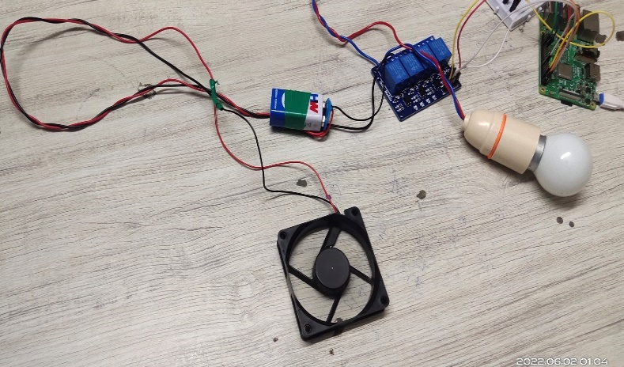

PREVIOUS PROGRESS RECAP
Developed a website for monitoring and controlling the home automation system.
Debugged the code to remove errors.
Website is linked with Raspberry pi and controlled the interfaced devices.
Interfaced the Bulb,Fan,Motion and temperature sensor with Raspberry pi.

Slide 53
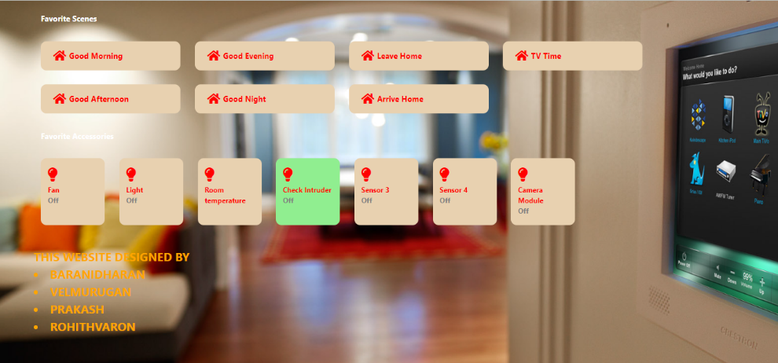
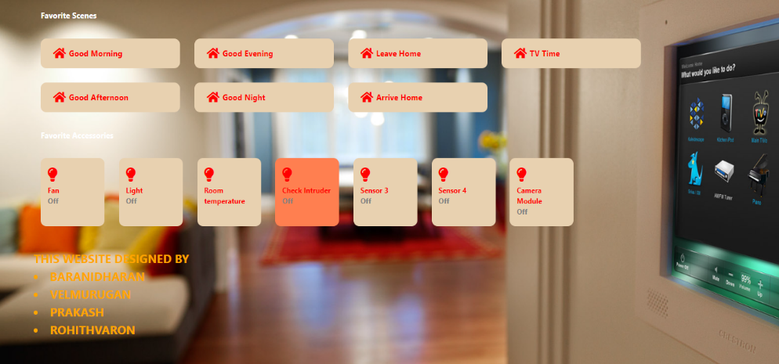
CURRENT PROGRESS
The motion sensor is interfaced with website and now we can easily receive the data from motion sensor.
Raspberry pi access the data from motion sensor and sent to web page.
If any intruders passes it gives an alert with the red signal otherwise it remains with green signal.
It also gives an alert message “INTRUDER DETECTED” and “INTRUDER NOT DETECTED”.

Slide 54
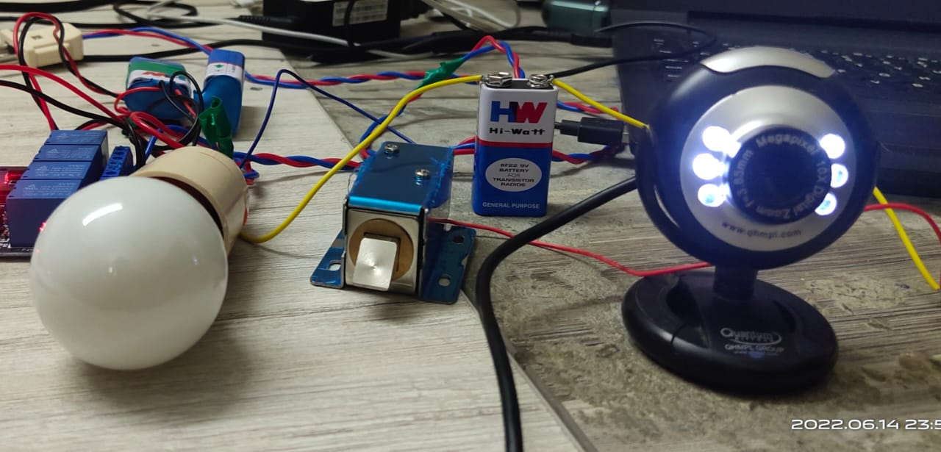
CURRENT PROGRESS
In FACE LOCK RECOGNITION part we created a data sets, by using the datasets we trained the recognizer.
If the dataset images are matched with the person who enters into the house, the lock will open.
Otherwise the lock will be immediately closed.
Lock will always remains in closed state.

Slide 55
PROBLEMS FACED
To connect an user interface website with the Raspberry pi ,we faced some errors .
PIR Sensor didn’t find the intruder perfectly ,we solved this problem by adjusting the sensitivity and modifying the codes.
For showing the alert system in the website we faced some errors because raspberry and website interface doesn’t support this alert system in website.
Camera is run in very slow state so some duration needs to capture the complete image and recognize.

Slide 56
REFERENCES
Antonakakis, Manos, et al. "Understanding the mirai botnet." 26th {USENIX} security symposium ({USENIX} Security 17). 2017.
2016 Design, Automation & Test in Europe Conference & Exhibition (DATE). IEEE, 2016.
DeMarinis, Nicholas, and Rodrigo Fonseca. "Toward usable network traffic policies for IoT devices in consumer networks." Proceedings of the 2017 Workshop on Internet of Things Security and Privacy. 2017.
Lau, Josephine, Benjamin Zimmerman, and Florian Schaub. "Alexa, are you listening? privacy perceptions, concerns and privacy-seeking behaviors with smart speakers." Proceedings of the ACM on HumanComputer Interaction 2.CSCW (2018): 1-31.
Hang, Guoming, et al. "Dolphinattack: Inaudible voice commands."Proceedings of the 2017 ACM SIGSAC Conference on Computer and Communications Security. 2017.
Subramanyan, Pramod, et al. "Verifying information flow properties of firmware using symbolic execution."

Slide 57
THANK YOU

